Slide 1

Online Doctor Appointment System

Slide 2
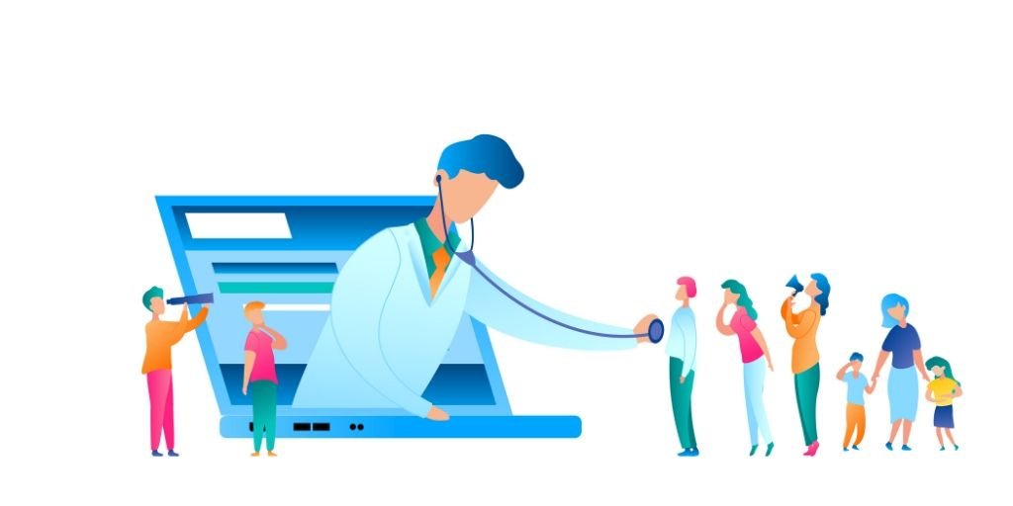
Institute for Advanced Computing & Software Development
Guided By
kashinath patil
Presented By
Gayatri Sharma
Komal Dhamankar

Slide 3
Abstraction
The proposed project is a smart appointment booking system that provides patients or any user an easy way of booking a doctor’s appointment online. This is a web based application that overcomes the issue of managing and booking appointments according to user’s choice or demands. The task sometimes becomes very tedious for the compounder or doctor himself in manually allotting appointments for the users as per their availability. Hence this project offers an effective solution where users can view various booking slots available and select the preferred date and time. The already booked space will not be available for anyone else for the specified time. This system also allows users to cancel their booking anytime..

Slide 4
Introduction
In our daily life we face a lot of problems. Disease is one of most common issues for a person’s life.If anybody is ill and wants to visit a doctor for checkup, he or she needs to visit the hospital and waits until the doctor is available. The patient also waits in a queue while getting appointment. If the doctor cancels the appointment for some emergency reasons then the patient is not able to know about the cancelation of the appointment unless or until he or she visits the hospital. So, it's necessary to get a consultation with Doctors whenever we got affected with various diseases. As the internet is now available for everyone therefore anyone can use the online appointment system to overcome such problems and inconvenience for the patients.

Slide 5
Objective
The main objective of the Project on Doctor Appointment System is to manage the details of Doctor Appointment Patient,Booking,
Doctor Schedule.It manages all the information about Doctor ,Doctor Fees,Doctor Schedule ,Doctor.The project is totally built at administrative end thus only the adminstrator is guaranteed the access.
The purpose of the project is to build an application program to reduce the manual work for managing the Doctor,Appointment,Doctor Fees,Patient.It tracks all the details about the Patient,Booking,Doctor Schedule

Slide 6
Modules
In this project ,we use spring boot and front end angular and mysql database
Admin
Patient
Doctor

Slide 7
Admin
Admin needs to login with username and password and in the admin home
screen, he can see the basic functionalities of admin. Admin can view the registered doctors and patients. He can also view the patient’s request and doctors requests and he will confirm the patients and doctors requests.
Patient
The patient needs to be registered and log in after logging on he can search for the doctor by giving availability, the reason or problem. Basing on the doctor availability the admin will confirm the booking request and will send to mail that the booking is confirmed he can also view in the status and he can also give feedback basing the performance of the doctor.

Slide 8
Doctor
Doctor need to be registered by giving the necessary details like timing, fees etc. After registering he need to log in and in the home screen he can view the basic functionalities. He can view the patient request forwarded from admin and he can accept and he can also view the feedback given by patients.

Slide 9
Frontend
HTML
CSS
ANGULAR
Backend
Spring Boot
My SQL
Software used
Eclipse
Msql
workbench
nodepad
npm

Slide 10
Advantages
This system helps to reduce the waiting time of the patient.
User can select the appointment time according to his preference.
Available and booked slots are shown in effective graphical user interface

Slide 11
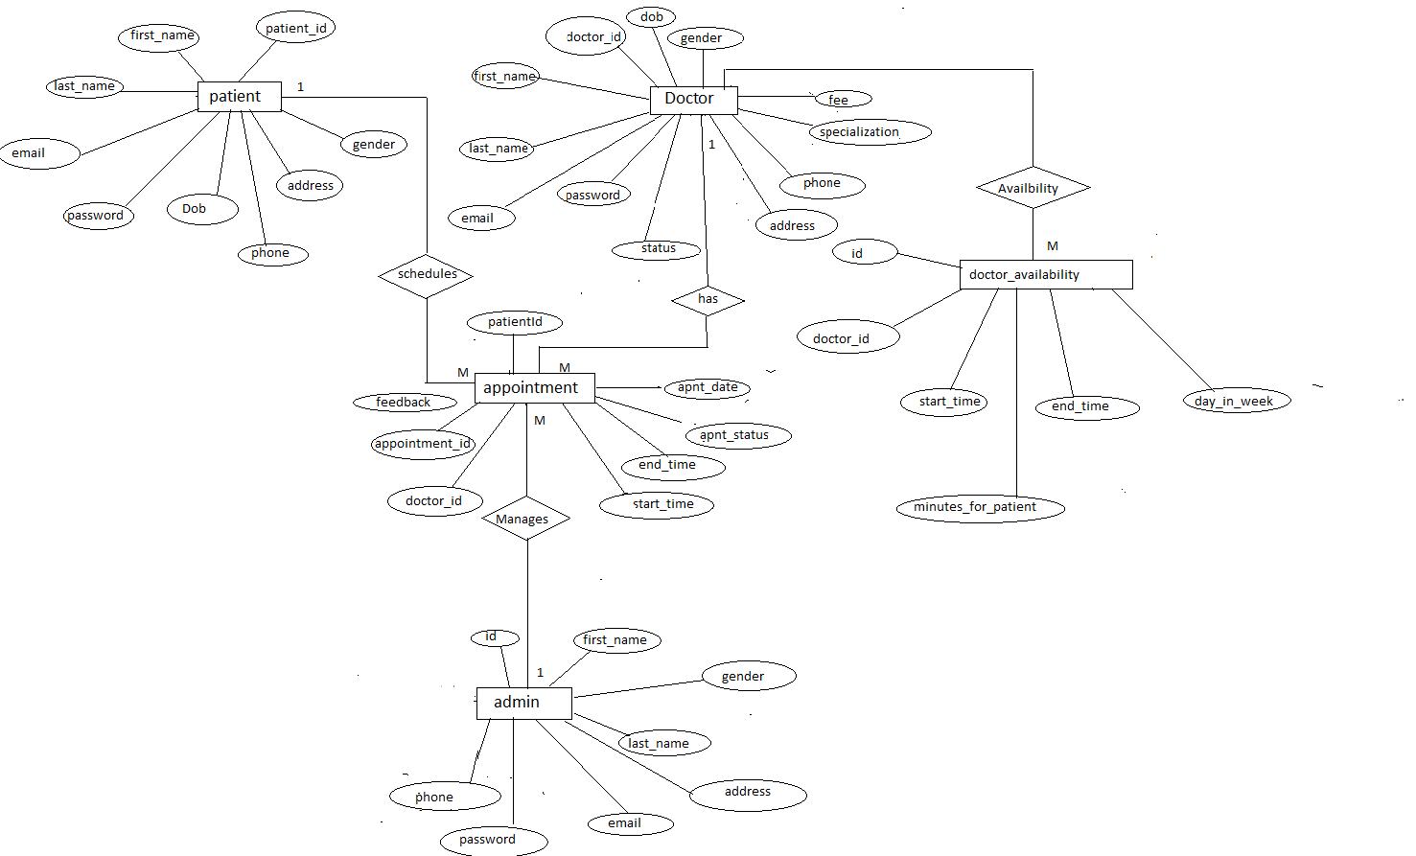
Er Diagram

Slide 12
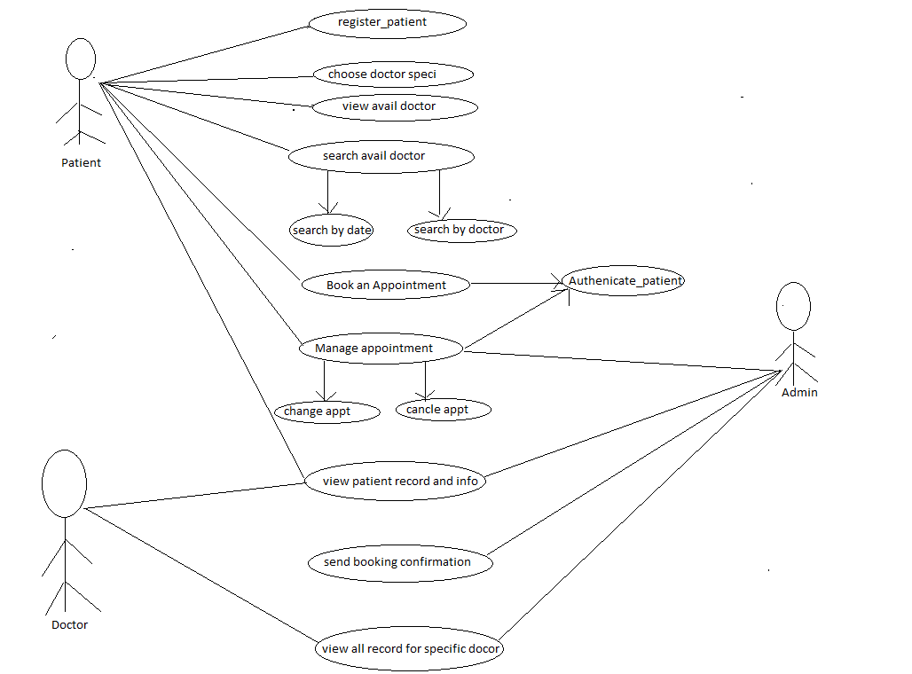
USE CASE Diagram

Slide 13
Future Scope
we can add printer in future.
we can give more advance software for doctor appointment system including more facilities.
we will host platform on online servers to make it accessible worldwide.
Integrate multiple load balancers to distribute the load of system.
Implement the backup mechanism for .taking backup of codebase and database on the regular basis on different servers.

Slide 14
Conclusion
Online appointment booking system that provides patients or any user an easy way of booking a doctor’s appointment online. This is a web based application that overcomes the issue of managing and booking appointments according to user’s choice or demands.
.

Slide 15
THANK YOU

